Slide 1
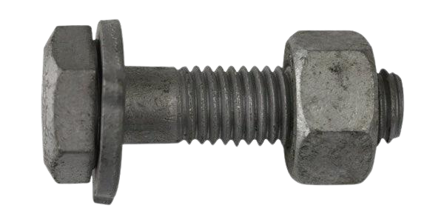
Threaded Fasteners
Prepared by:
Er. Bibek Magar
BE in Automobile Engineering
IOE, Thapathali Campus
bibek.magar@thc.tu.edu.np

Slide 2
Introduction
Threaded fasteners are temporary fasteners. They are useful because parts connected by threaded fasteners can be readily separated as and when required. Some common examples of threaded fasteners are bolts, nuts and screws.
Usually a machine is built up by assembling various parts that are connected to each other by threaded fasteners so that they can be easily disconnected for repair and maintenance.
In this Lecture, we are going to learn about the basic concepts of representing threaded fasteners in Engineering drawing.
Primarily, the lecture is focused on learning how to draw:
Hexagonal nut, and bolt
Square bolt
Stud

Slide 3
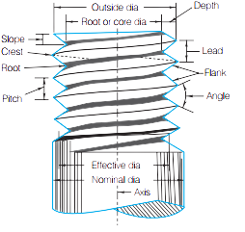
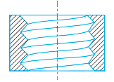
Some Important Terminologies
External thread : It is a continuous helical ridge on the external surface of a cylinder. Threads on bolts, studs or screws are examples of external threads.
Internal thread : It is a thread on the internal surface of a cylinder. The thread on the surface of a hole of a nut is an internal thread.
Pitch (P) : The distance between the corresponding points on adjacent threads measured parallel to the axis is known as the pitch of the thread.
Crest : It is the edge of the thread surface farthest from the axis in the case of external threads and nearest to the axis in the case of internal threads.
Root : It is the edge of the thread surface nearest to the axis in the case of external threads and farthest from the axis in the case of internal threads.
Major diameter : It is the diameter of an imaginary coaxial cylinder just touching the crests of the external threads or the roots of internal threads. It is the largest diameter of a screw thread. In the case of external threads, the major diameter is also known as the outside diameter or crest diameter.
Minor diameter : It is the diameter of an imaginary coaxial cylinder just touching the roots of external threads or the crests of internal threads. It is the smallest diameter of a screw thread. In the case of external threads, the minor diameter is also known as the core diameter or root diameter
Nominal diameter : It is the diameter by which the threads are designated.

Slide 4
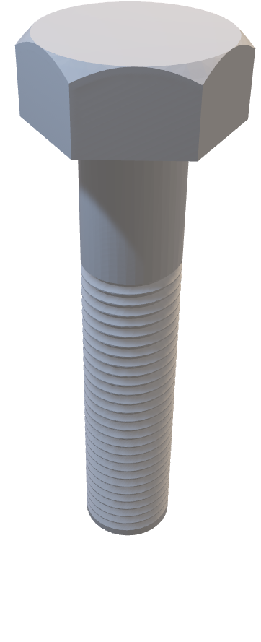
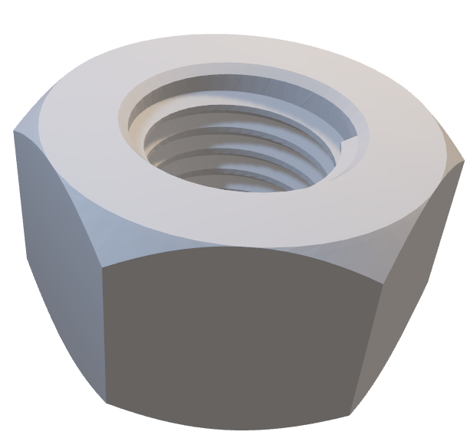

Slide 5
Hexagonal Bolt
d₁
d
d₂
Empirical Formulae for constructing a hexagonal bolt
d = nominal diameter
d₁ = 2 d
d₂ = 0.8 d
t = thickness of head = 0.75 d
x = Total length of the shank
y = threaded portion of the shank
R3 = 1.5d
R1, and R2 are found from geometrical construction
t
30°
R3
R2
R1
x
y

Slide 6
Hexagonal Nut
d₁
d
Empirical Formulae for constructing a hexagonal nut
d = nominal diameter
d₁ = 2 d
d₂ = 0.8 d
t = thickness of head = d
The radius on the faces due to chamfer are constructed using the same method used for the bolt.
d₂
d

Slide 7
Metric System
Pitch of the thread
Total length of the Shank
Hexagonal Head
Hex M16 × 1.5 × 40/60
Nominal Diameter
Threaded portion of the Shank

Slide 8
Square Bolt
W
d
d₁
Empirical Formulae for constructing a Square bolt
d = nominal diameter
W = 1.5d + 3
d₁ = 0.8 d
t = thickness of head = 0.8 d
x = Total length of the shank
y = threaded portion of the shank
R = 2d
R
t
x
y

Slide 9
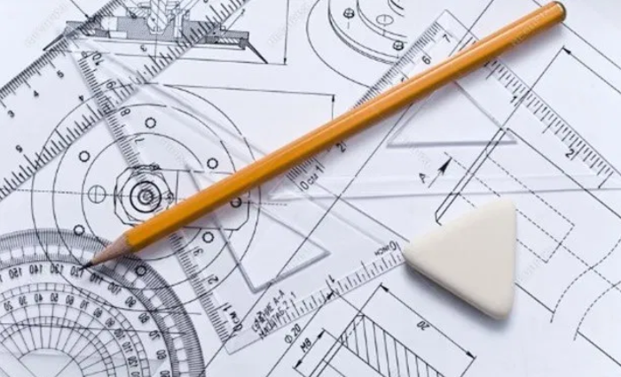
Solved Examples:

Slide 10
Q1) Make the conventional three views of Hex M16 ×3 × 40/60
30°
R2
R1
R3
30°

Slide 11
Q2) Make the conventional three views M16 nut.

Slide 12
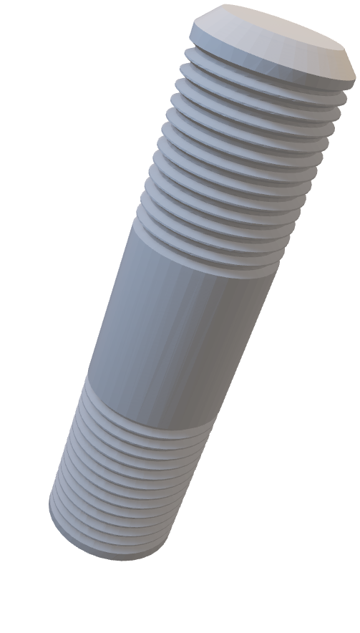
Stud

Slide 13
Q3) Make the conventional views of Stud M20 20/60.

Slide 14
Q4) Make the conventional views of SQ bolt of M20.
R

Slide 15


